Slide 1
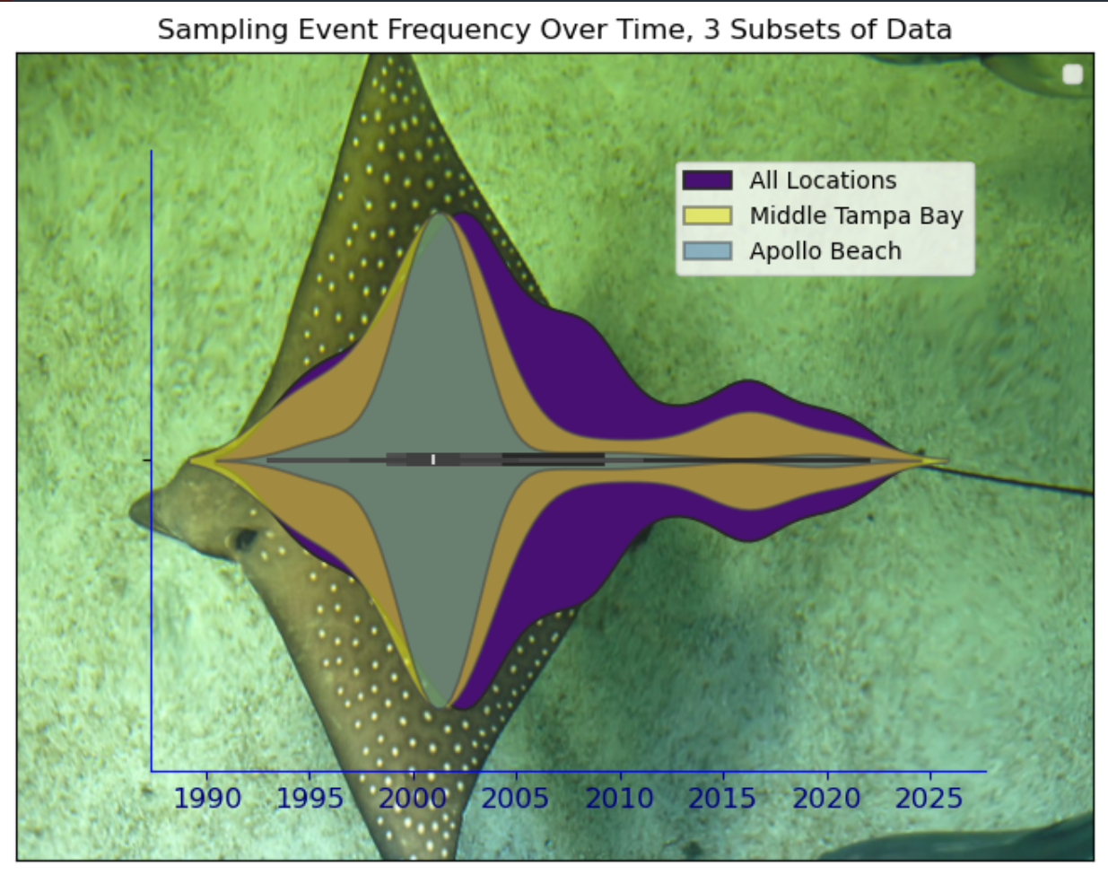

a statistical approach to evaluation of environmental mitigation featues
A case study of anthropogenic environmental degradation & using modelling and ML to find a middle path of sustainability
Arjun Joshi
Data Scientist Developer Marine Scientist
J&J Asset Management
Tampa, FL
ArjunJoshi@JJAssetManagement.com

Slide 2
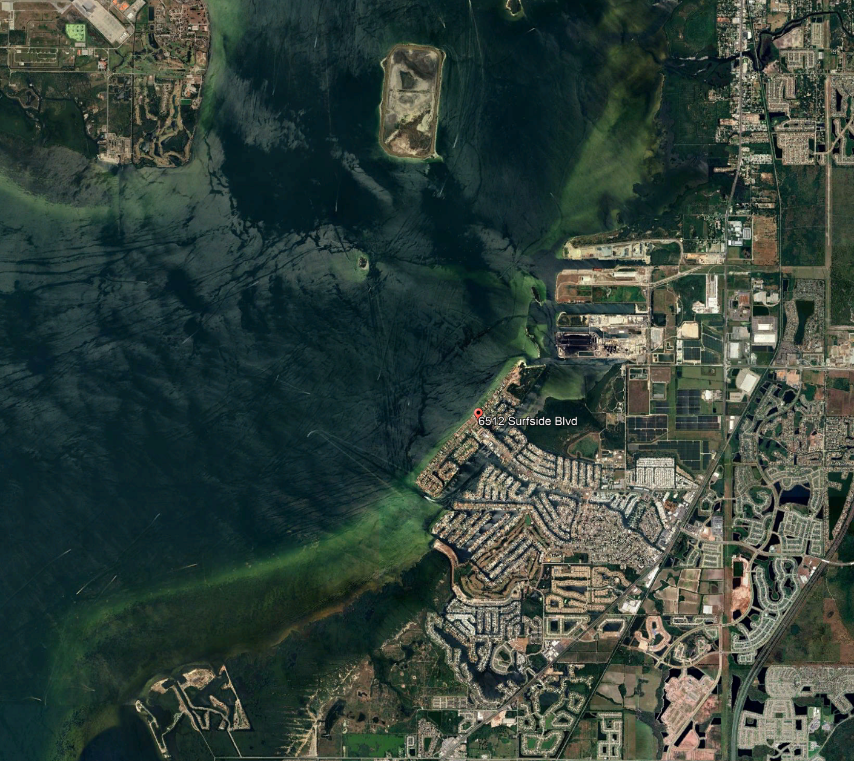
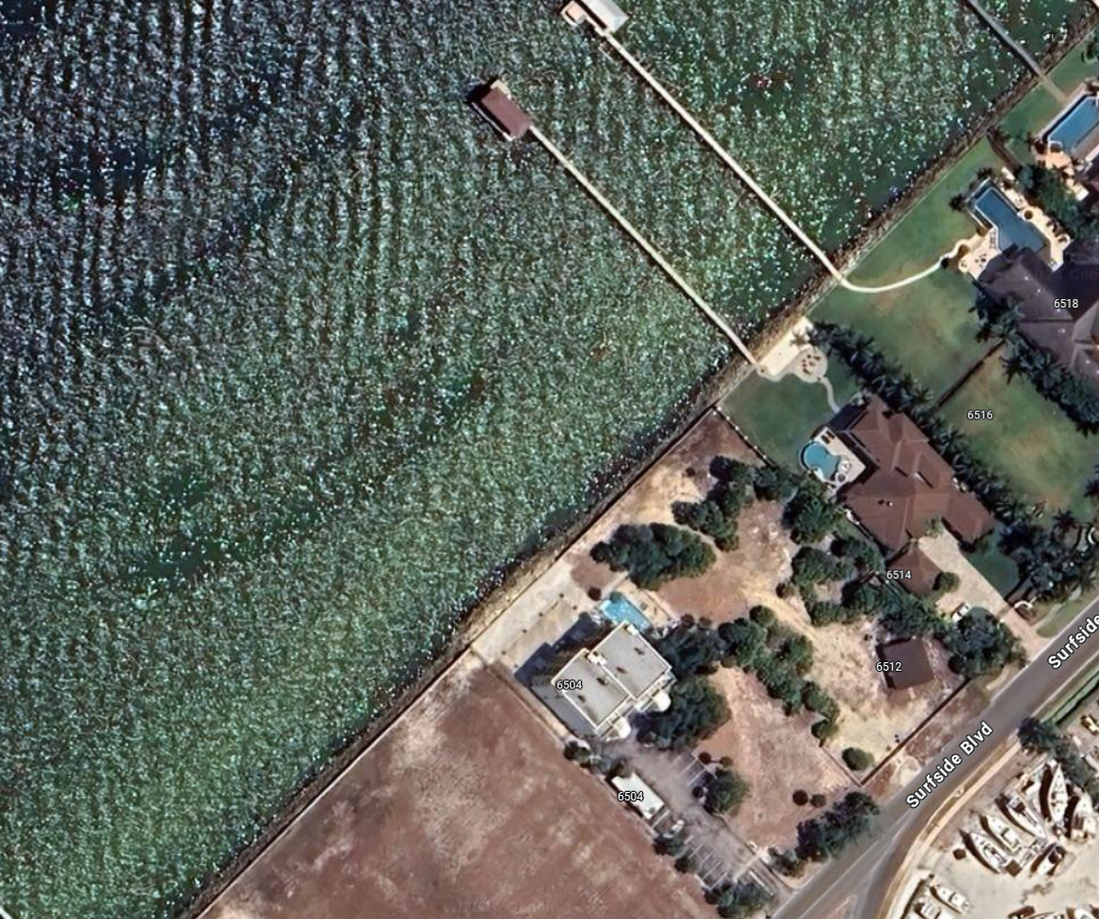
Apollo beach, tampa bay (site of case study)

Slide 3
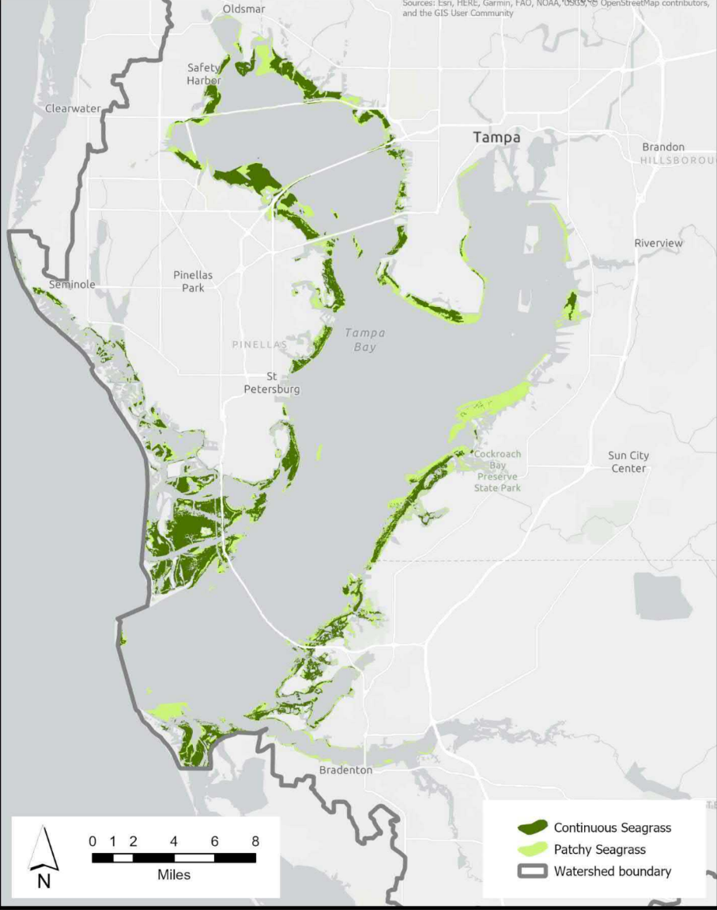
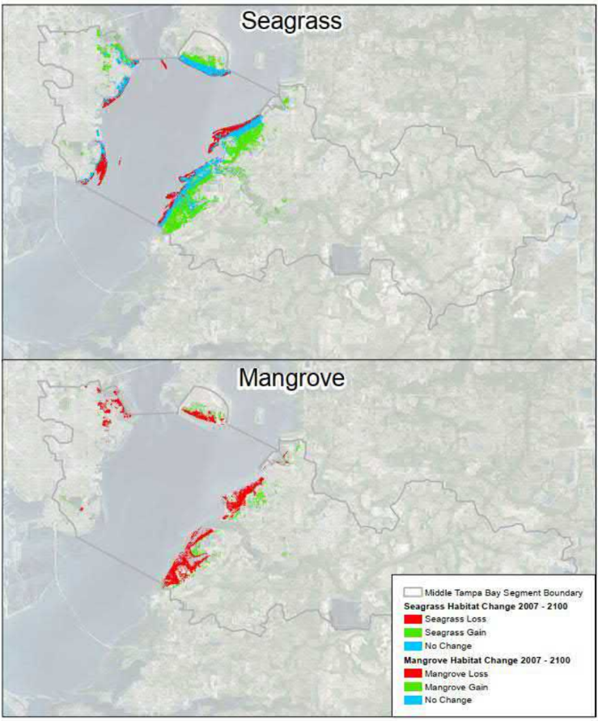
Tampa bay’s ecosystem: complex and unique habitats
Left: Seagrass habitats across Tampa Bay
Right: Middle Tampa Bay, primary coastal habitat coverage
Primary coastal ecosystems in Middle Tampa Bay

Slide 4
objective and targets: Indices
Purpose of the Study:
Selection of the optimal or most positively impacting mitigation feature.
Example: Artificial Oyster Reef,
High Level Strategy:
Use composite Indices as normalized proxies of ecosystem health or negative environmental impact.

Slide 5
COMPETEING INTERESTS: Economic drivers
Business And Government:
Multifaceted investment strategy to stimulate local economy by growth in new industry sectors. Includes corporate investment in infrastructure
Maturing into an insulated housing market
Waterfront properties sell for 40%
Case Study: Apollo Beach
Investment in a commercial dock with 36 slips:
$640,000 year Gross Profit in private rentals
Add-ons for:
- Slip fees
- Fuel
- Ramp fees
Risks:
- Water Contamination
- Maintenance
- Wildlife Endangerment
- Mostly deemed irrelevant
For the Snowbird (term for residents moving down from the North) :
Below Median Cost of Living
New Tech and Finance Jobs
Influx of young adults and money
Ref: ¹Tampa Bay Times, 2018 (link)

Slide 6
WHY IT’S IMPORTANT: ENVIRONMENTS PROTECT COMMUNITIES
WATERSHED POLLUTION
HARMFUL ALGAL BLOOMS
IMPACTS ON HUMAN HEALTH
ENVIRONEMTAL BUFFERS
ECONOMIC IMPACTS
TOURISM
LOCAL INDUSTRY
PROPERTY VALUE

Slide 7
The Data set: EDA is subset focused on benthos data
HUMAN IMPACT DATA
CONSTRUCTION ACTIVITY
MARINE ACTIVITY
POLLUTION
NITRATE/PHOSPHATE LOADING
ENVIRONMENTAL DATA
BENTHOS (SEAFLOOR)
OPEN WATER
SEAGRASS
MANGROVES
ESTUARIES
WATERQUALITY

Slide 8
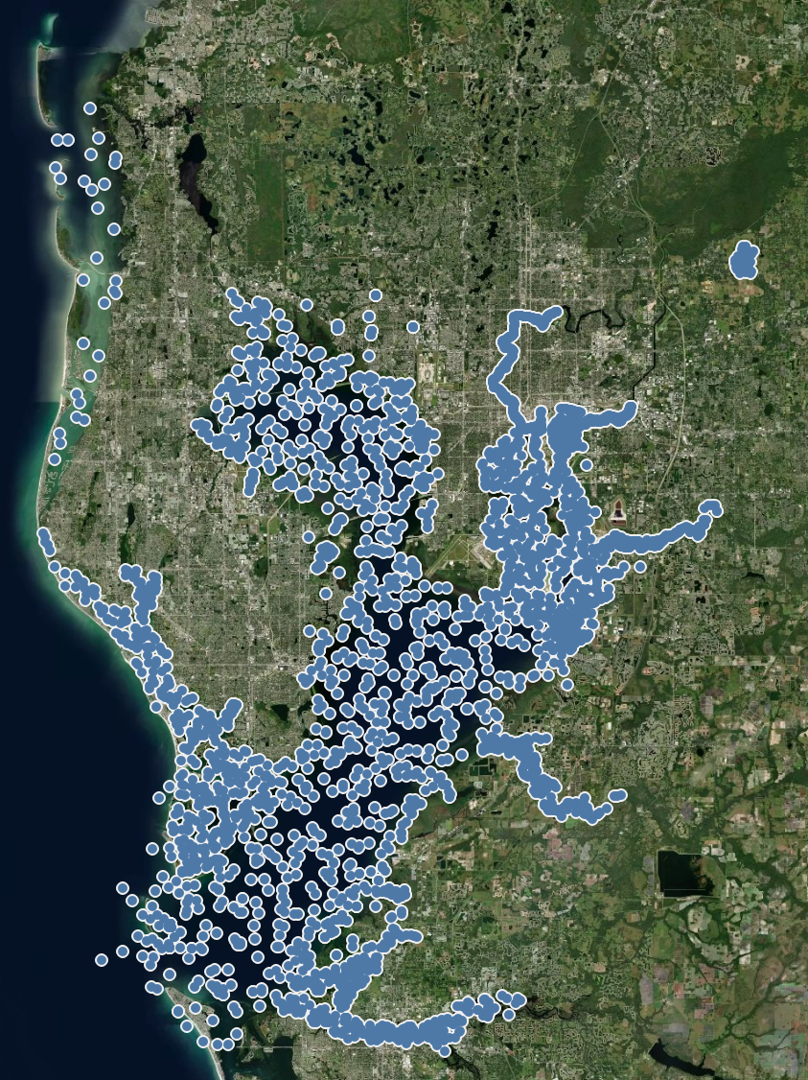
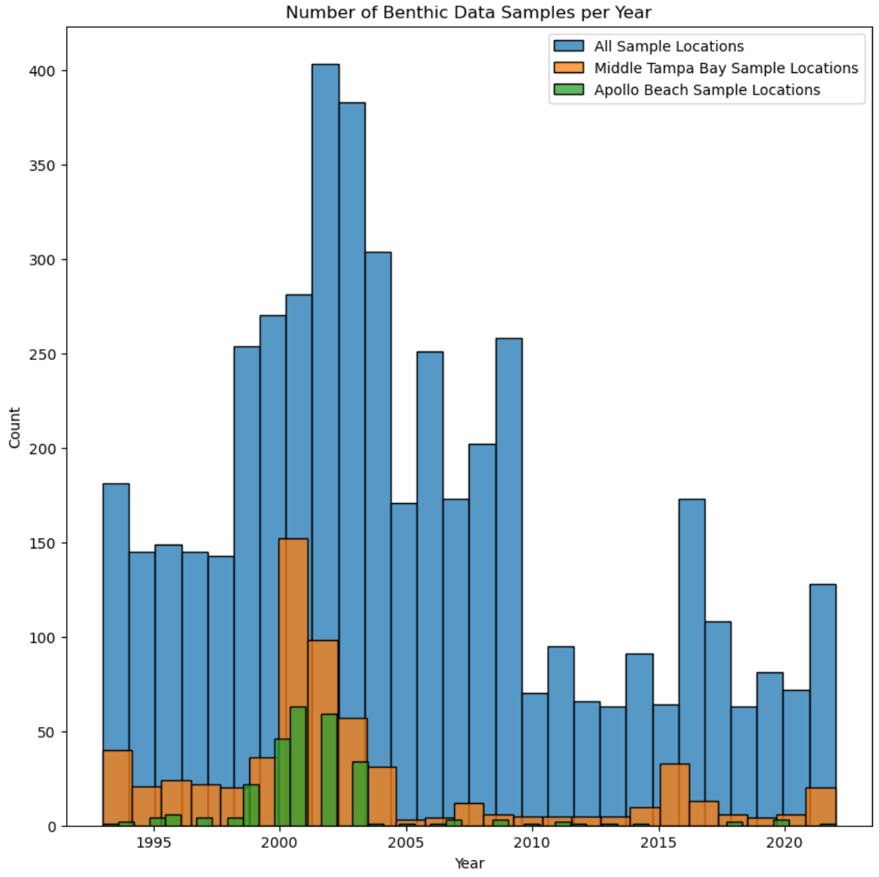
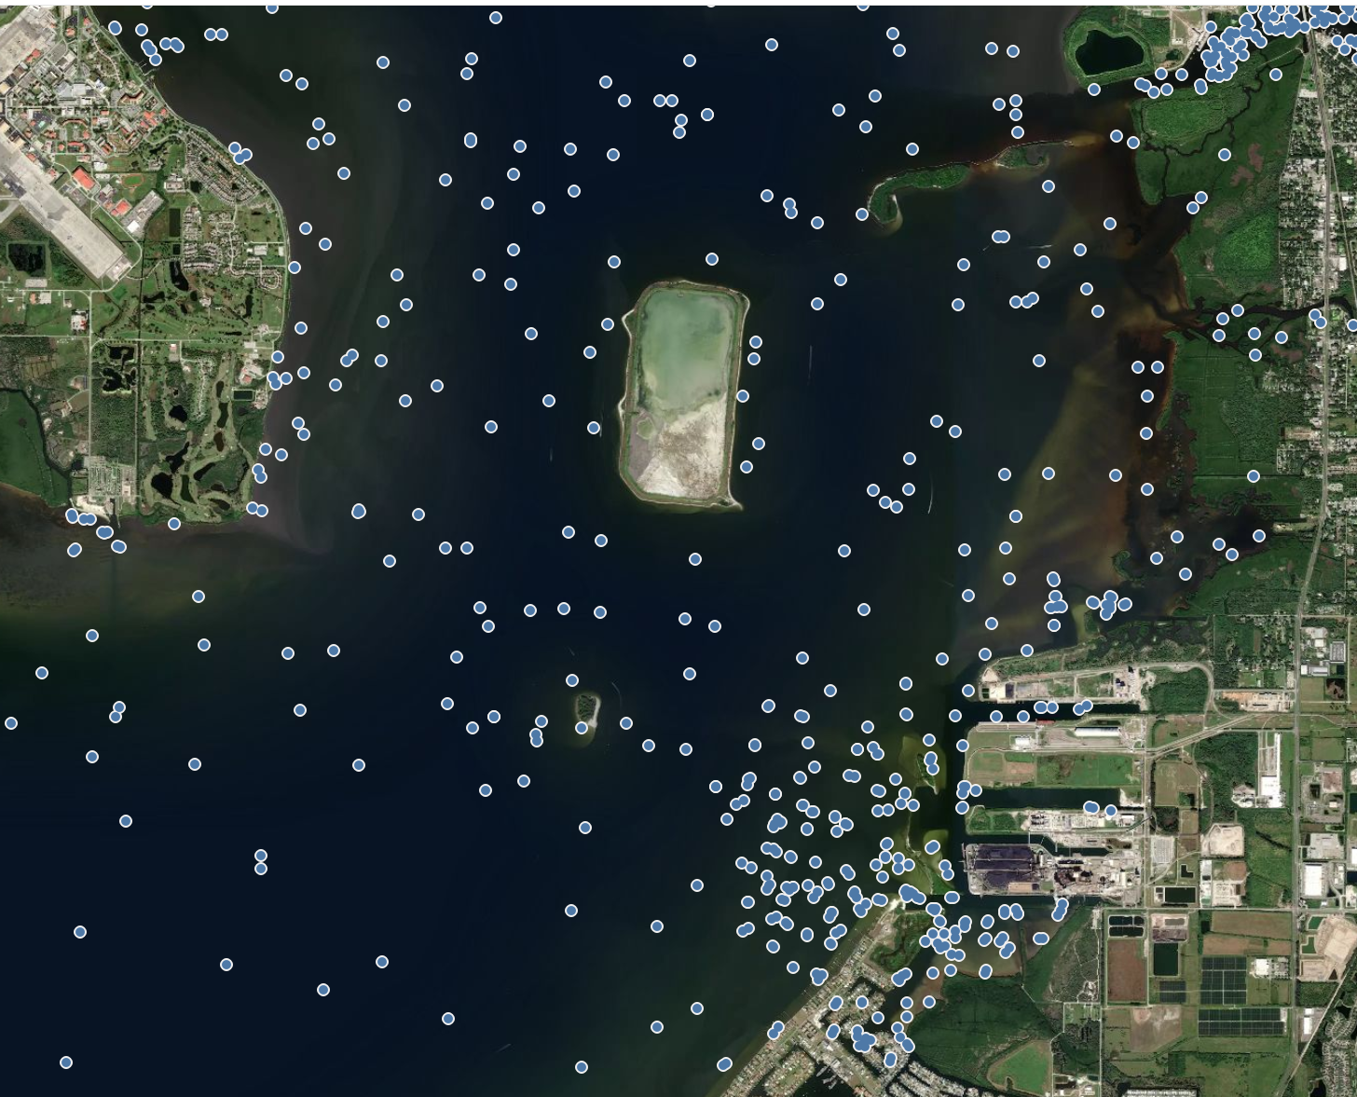
Sampling events

Slide 9
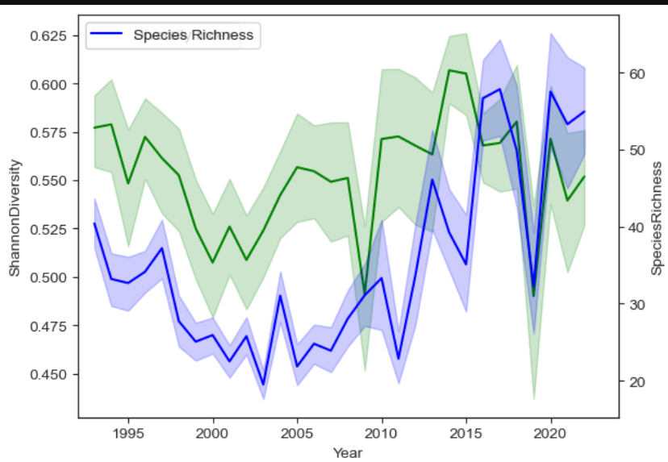
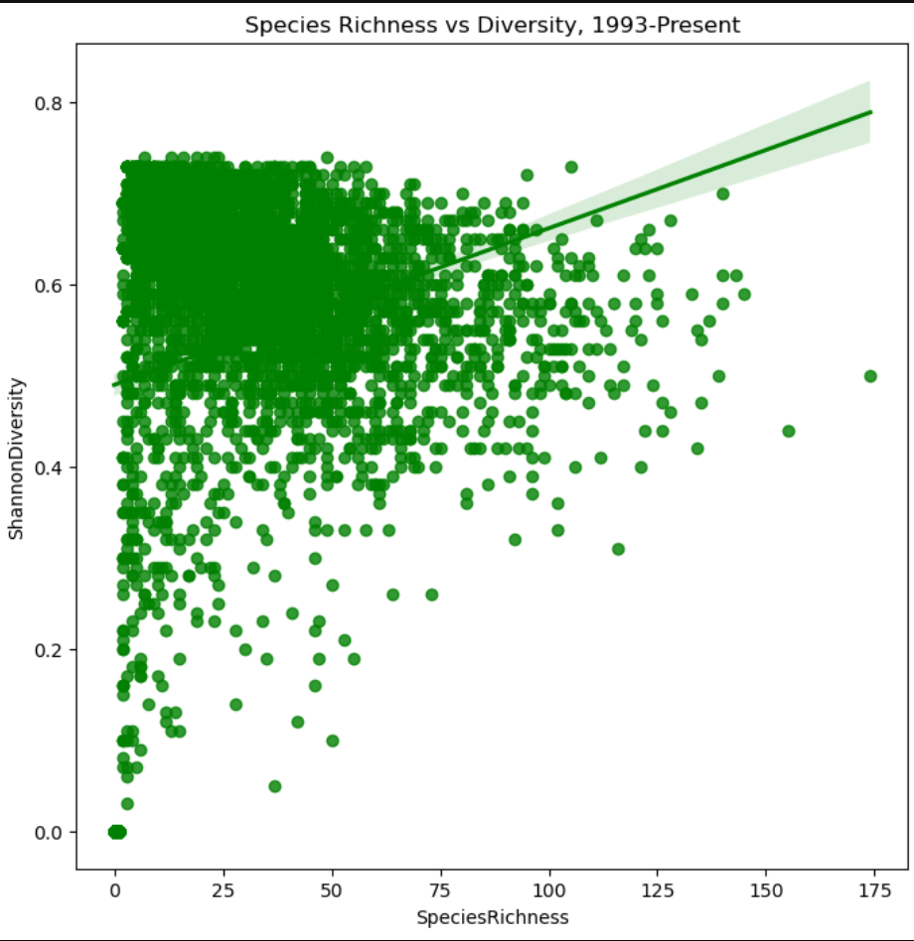
Diversity as an index: NORMALIZED VALUE FOR ALL DATASETS

Slide 10
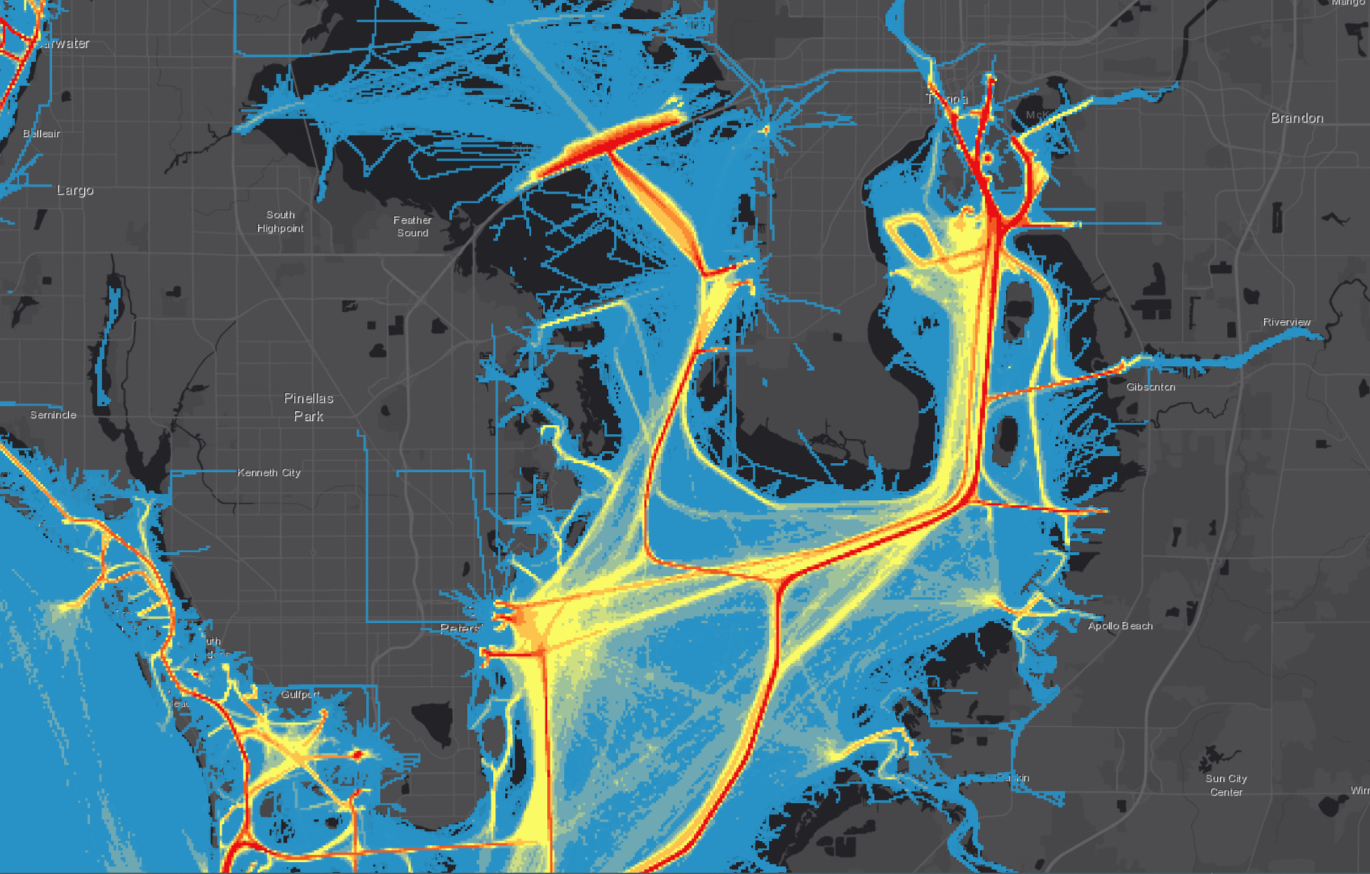
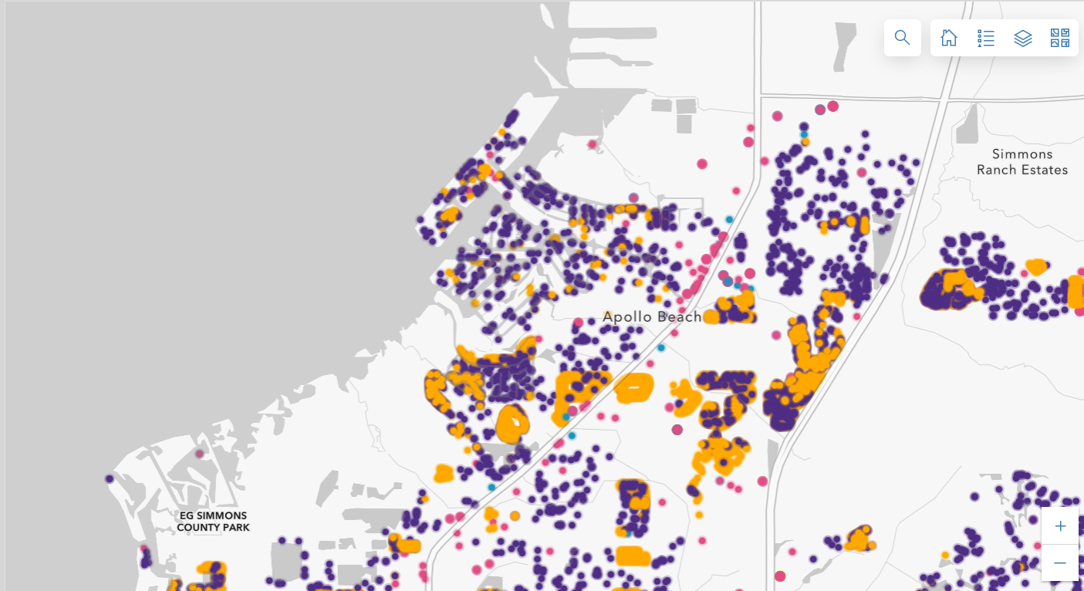
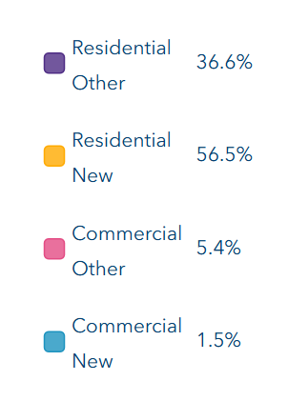
Causes of environmental degradation
Vessel Activity:
Commercial
Recreational Marine Traffic
Coastal Construction

Slide 11
challenges
DATA AVAILABILITY
DATA CLEANING
LARGE, DATASET
NON UNIFORM SAMPLING EVENTS
SKEWED DATA SOURCES

Slide 12
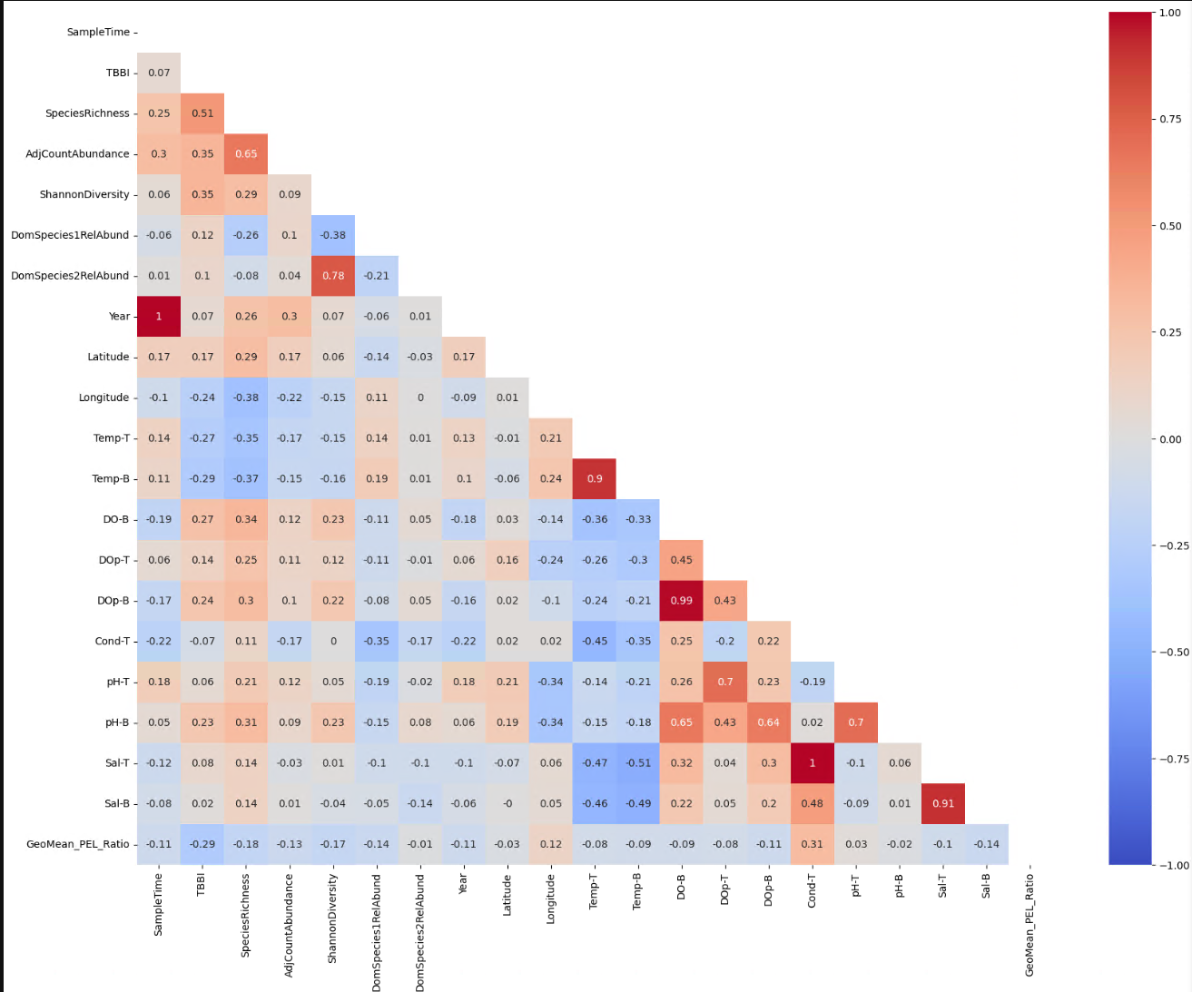
Next steps

Slide 13
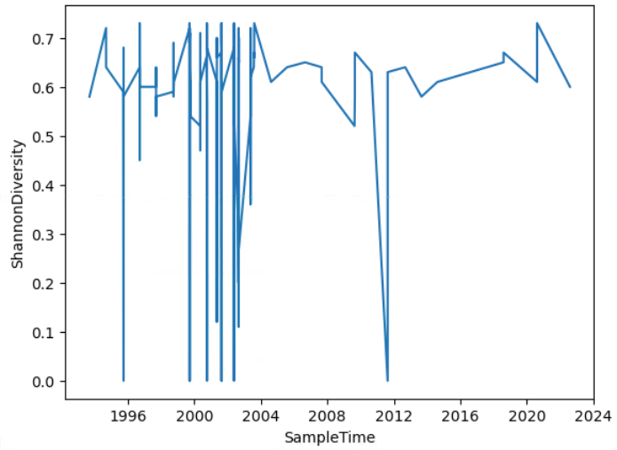
Next steps
EXPAND PREPROCESSING FOR OTHER HABITATS
LOOK AT CATASTROPHIC EVENTS
REDUCE FEATURES
ESTABLISH RELATIONSHIPS BETWEEN INDICES

